Slide 1
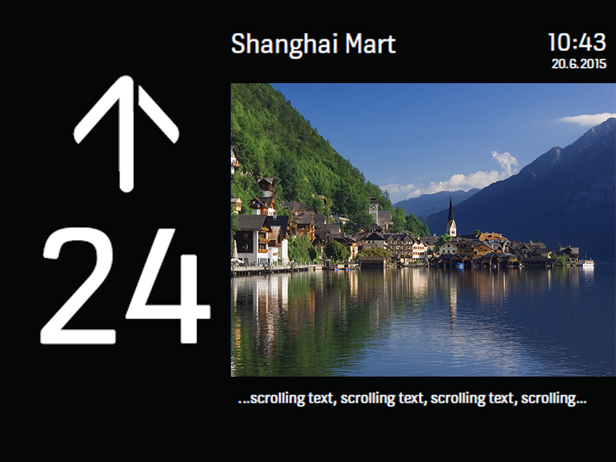
MediaScreen ContentMgmt
V3.0
Interface preview
V3.0
Preview effect
Full screen preview
Screen parameter configuration
Brightness, sound, date and time format, time zone
Horizontal screen preview
Vertical screen preview
Media content editing
Media resources, announcement text information
Network access settings
Cloud network APN information setting, LAN IP address setting
Select upgrade U disk
Make
Preview
One-click restore default settings
中文 English 繁体
Back
Language switching

Slide 2
Screen parameter configuration
V3.0
Brightness setting
20%
Sound settings
20%
Date & Time Format
2018:06:01
12 AM/PM
01:06:2018
Date
time
2018 Y
6 M
7 D
8
55
Automatic time zone
Select time zone
CMT + 08:00 China Standard Time
cancel
save

Slide 3
Default is off, normal display state
Media content editing
V3.0
Resource Type
Full screen playback
Media
Audio
Pictures
Resource select
Selected by default
Display title and text information. When the click is unchecked, the information is hidden
Title
Enter the title information and scrolling caption information to be updated. If it is empty, it is regarded as not modified.
Announcement text information
cancel
save

Slide 4
Network access settings
V3.0
Cloud APN settings
Country：
Network：
APN：
User：
MCC：
MNC：
Password：
LAN settings
The default is to automatically obtain the IP address
Auto
IP address ：
. . .
Subnet mask ：
. . .
Gateway：
. . .
DNS:
. . .
cancel
save

